Slide 1
COMPUTER VISION DA3 DROWSINESS DETECTION USING HAAR TRANSFORMS AND EAR ALGORITHM IN OPEN CV BY : K.P.S.Shivratna

Slide 2
INTRODUCTION

Slide 3
In India driver fatigue results in over 50% of the road accidents each year. Using technology to detect driver fatigue/drowsiness is an interesting challenge that would help in preventing accidents. The focus will be placed on designing a real-time system that will accurately monitor the open or closed state of the driver’s eyes. Detection of fatigue involves the observation of eye movements and blink patterns in a sequence of images of a face extracted from a live video

Slide 4
System Design

Slide 5
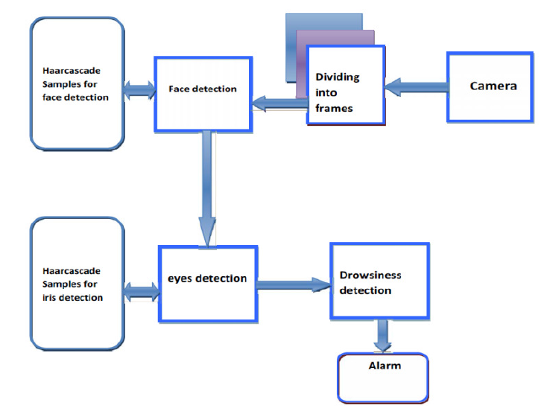

Slide 6
Module Description

Slide 7
Video acquisition: Video acquisition mainly involves obtaining the live video feed of the automobile driver. Video acquisition is achieved, by making use of a camera. Dividing into frames: This module is used to take live video as its input and convert it into a series of frames/ images, which are then processed. Face detection: The face detection function takes one frame at a time from the frames provided by the frame grabber, and in each and every frame it tries to detect the face of the automobile driver. This is achieved by making use of a set of pre-defined Haarcascade samples. Eyes detection: Once the face detection function has detected the face of the automobile driver, the eyes detection function tries to detect the automobile driver's eyes. This is achieved by making use of a set of pre-defined Haarcascade samples. Drowsiness detection: After detecting the eyes of the automobile driver , the drowsiness detection function detects if the automobile driver is drowsy or not , by taking into consideration the state of the eyes , that is , open or closed and the blink rate.

Slide 8
HAAR Cascade ALGORITHM

Slide 9
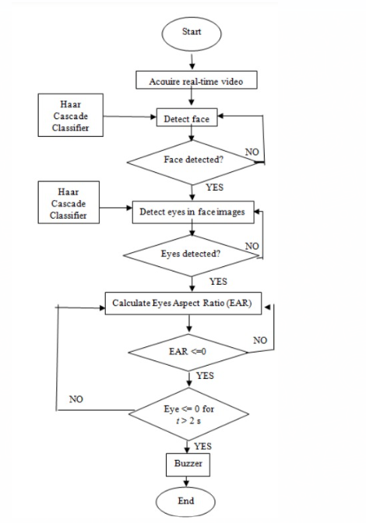

Slide 10
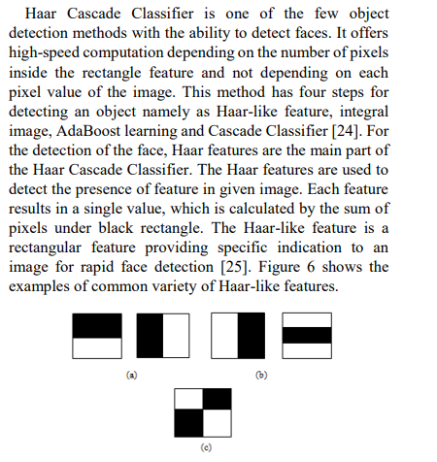

Slide 11
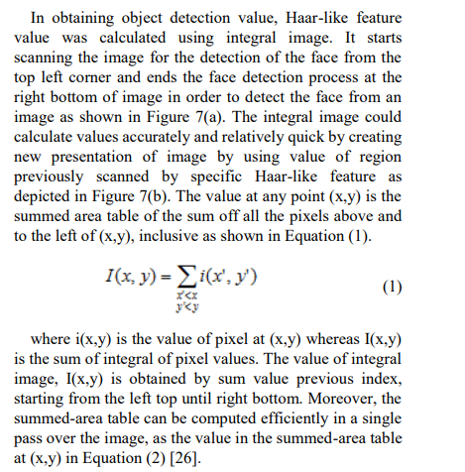
Haar Cascade algorithm

Slide 12
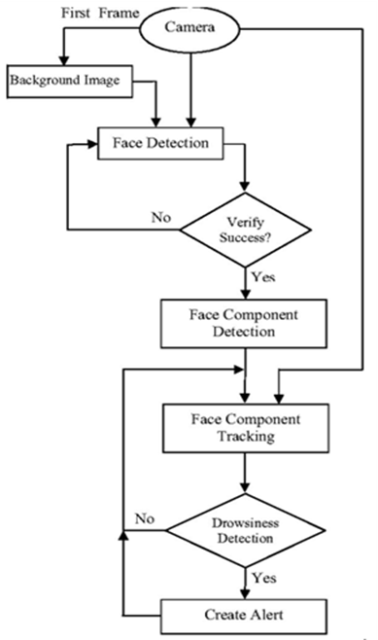
The Algorithm detects the face in the pre-processed image by using facial landmarks produced by dlib library.
In the detected face region, the algorithm finds the face landmark
To detect eye region, the correct array slices from the set of face landmarks is detected.
Set the ear threshold = 0.25.
Calculate EAR (eye aspect ratio) to determine whether the eyes are closed or not while driving.
Check to see if the eye aspect ratio is below the “blink/closed” eye threshold.
If it is, increment counter, the total number of consecutive frames where the person has had their eyes closed.
If the counter is greater than 50, alarm sounds and “Alert!” Is created

Slide 13
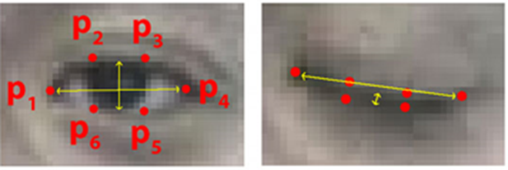
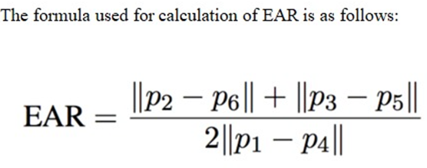
Algorithm to calculate the EAR(Eye Aspect Ratio)
EAR algorithm:
Step 1: Use the Detected Eye region from the algorithm.
Step 2: Compute the Eye Aspect Ratio to determine if the eyes are closed.
Step 3: If EAR satisfies the drowsy condition then move to step 5.
Step 4: If EAR is normal then go to Step 1.
Step 5: Sound Alarm.

Slide 14
SNAPSHOTS OF IMPLEMENTATION

Slide 15
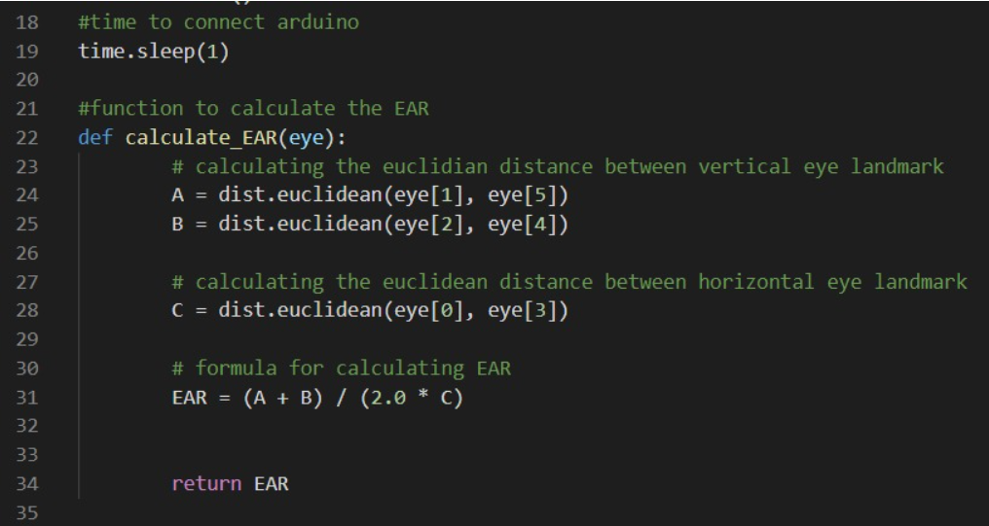

Slide 16
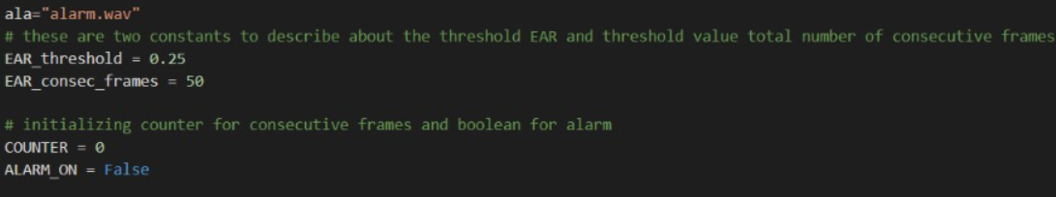

Slide 18
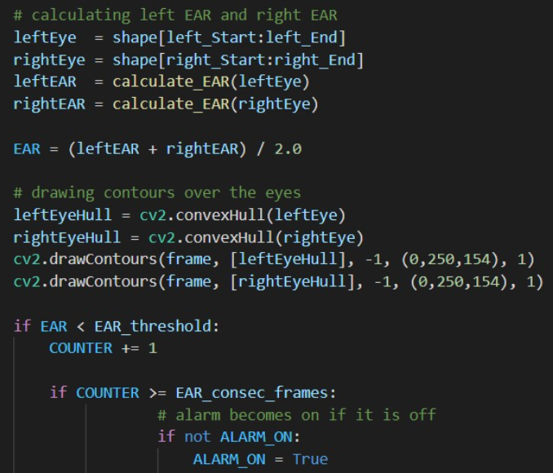

Slide 20

SOFTWARE/HARDWARE IMPLEMENTATION

Slide 21
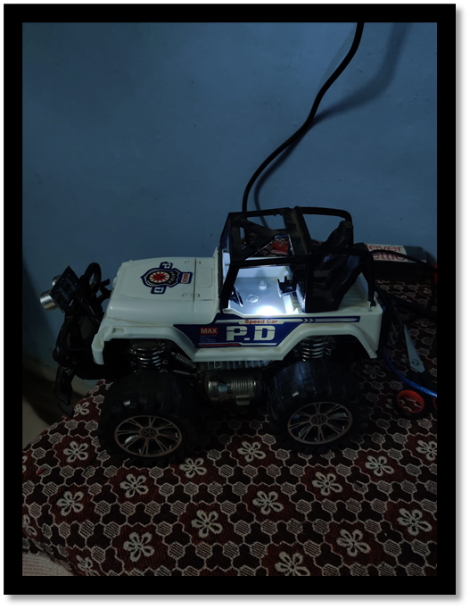
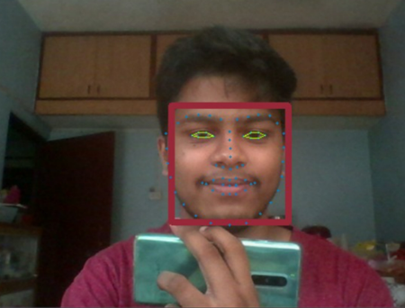
OUTPUT
NO ALARM
EYES OPEN

Slide 22
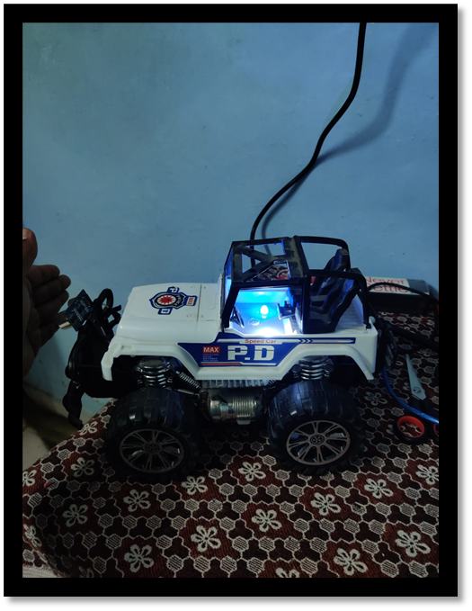
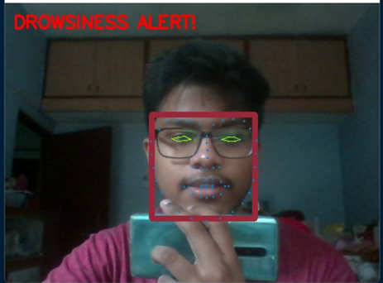
OUTPUT
ALARM!!
EYES CLOSED

Slide 23
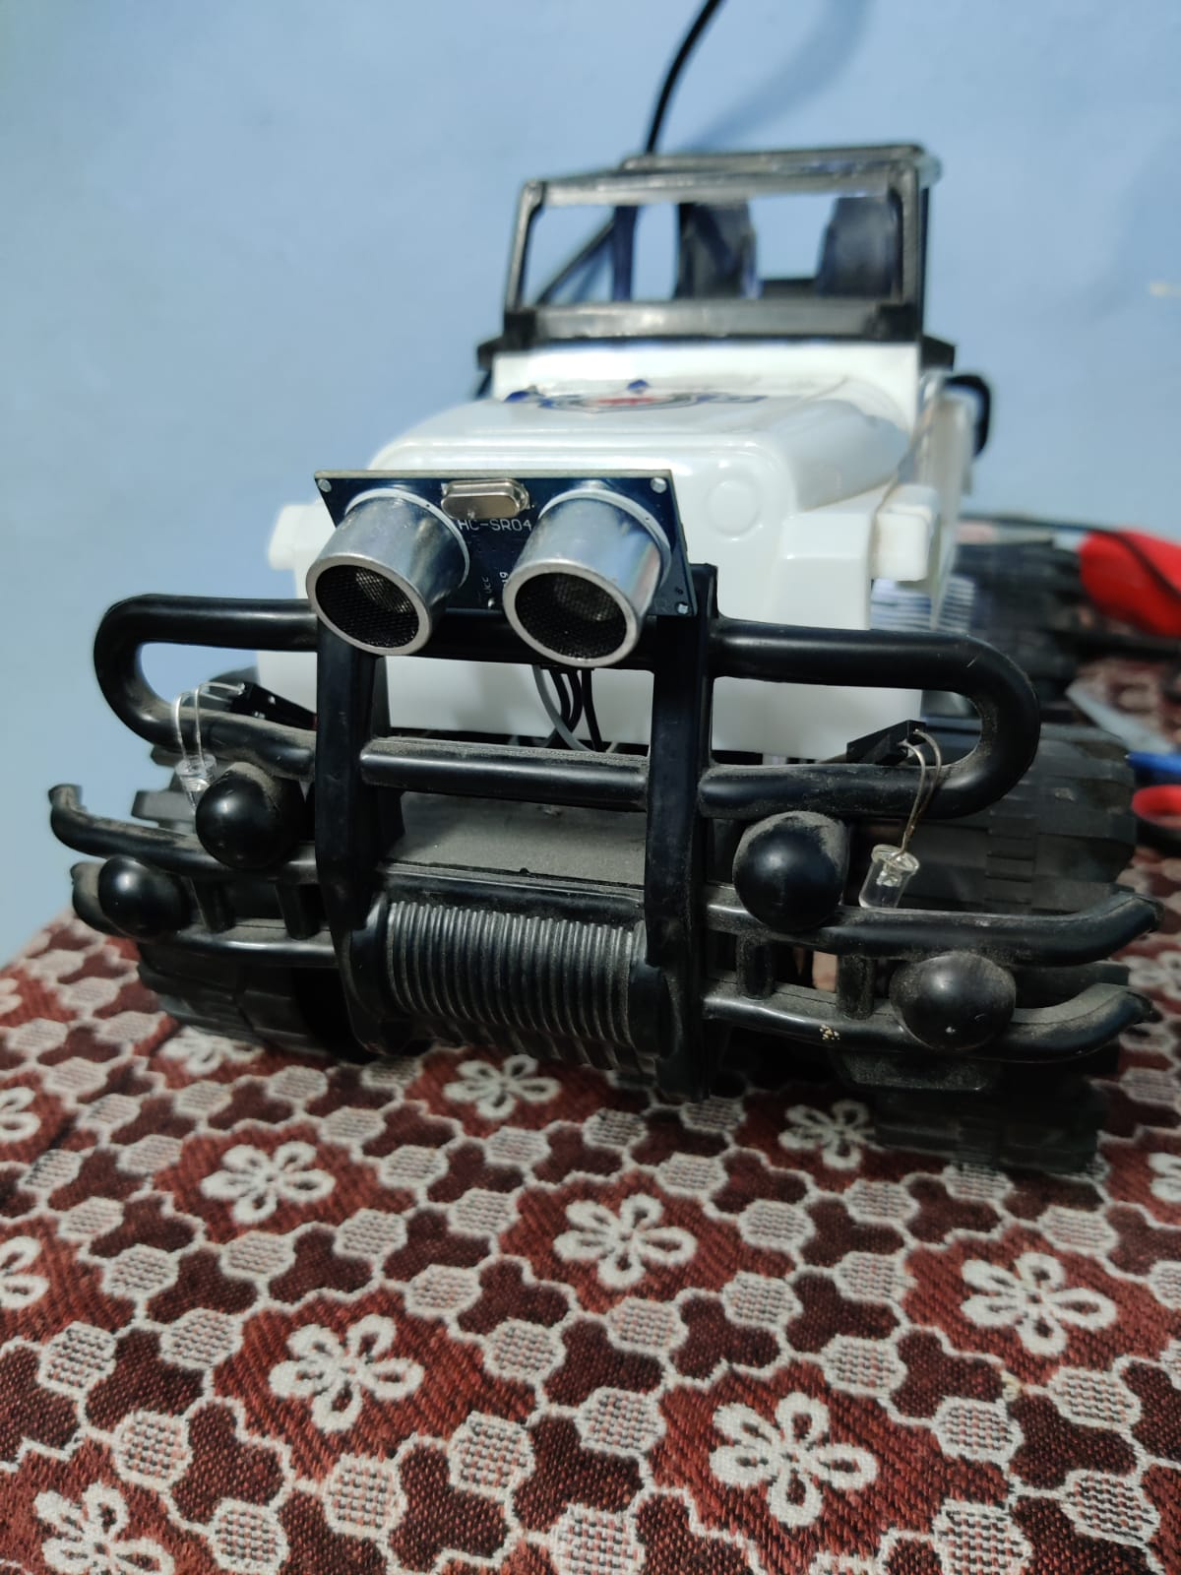
Ultrasonic sensor in front of car also left and right indicator when driver falls asleep while driving system is alerted and indicator start blinking to inform nearby users to pass slowly

Slide 24
THANK-YOU

